Slide 1
RAN HLD

Slide 2
RAN HLD
Strategic Plan & Scope
High Level Network Architecture
Network Design
Deployment
Operations & Maintenance
Field Maintenance
Post-Launch Engineering
Supply Chain Management
Strategy
Business Rules
Service Requirements
Engineering Specifications
Approved Equipment
Site Survey data
Network Design
RAN HLD
RAN LLD
TX Network HLD
TX Network LLD
Civil & Power Design
to Deployment
Mobile Core HLD
Mobile Core LLD
NFVI Dimensioning

Slide 3
RAN HLD
Network Requirements
Initial Radio Network Design
Radio Network Design Report
Network Architecture
Operator’s Network Database
Site Survey Reports
RF Equipment selected
Geodemographic data layers
Quality objectives
Traffic profiles
Prework and Data Collection
Current Network audit
Coverage objectives definition
Site Survey Analysis
Master Database Creation
Radio Configuration Definition
RAN HLD Report
Capacity Demand Forecast
Radio Planning Tool Selection and Configuration
Link Budget
Infrastructure and Equipment Requirements
Capacity Planning
Model Site Catalogue Generation
RF Equipment BoQ
Nominal Site Location estimation
Service level requirements
RF Site Configuration definition
Coverage plots generation
Site Location Validation
Input
Process
Subprocess
Output
Greenfield Only
Overlay Only

Slide 4
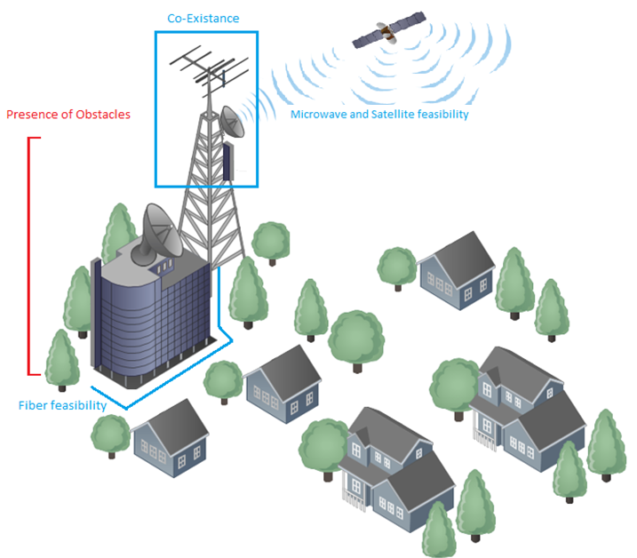
RAN HLD

Slide 5
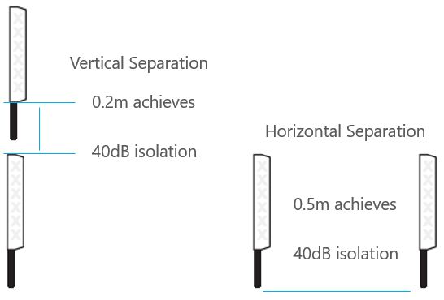
RAN HLD

Slide 6
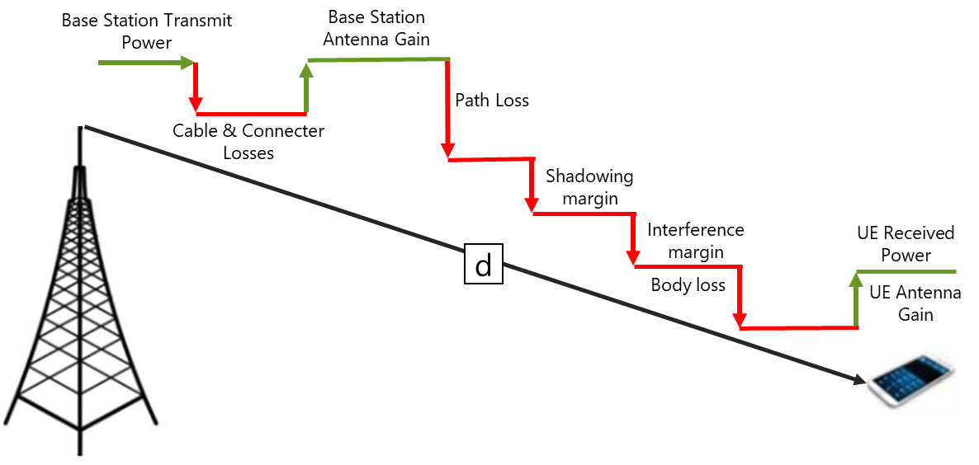
RAN HLD

Slide 7
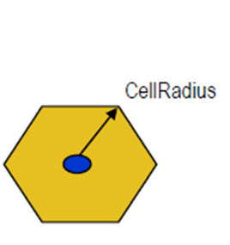
RAN HLD

Slide 8
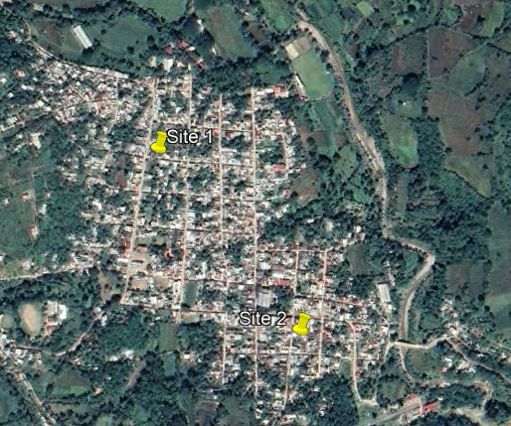
RAN HLD

Slide 9
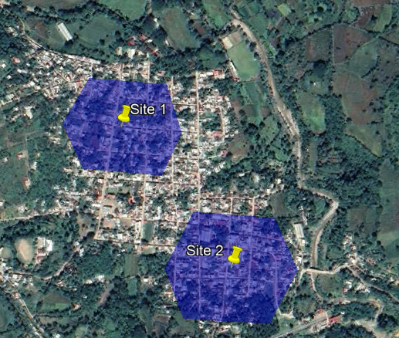
RAN HLD

Slide 10
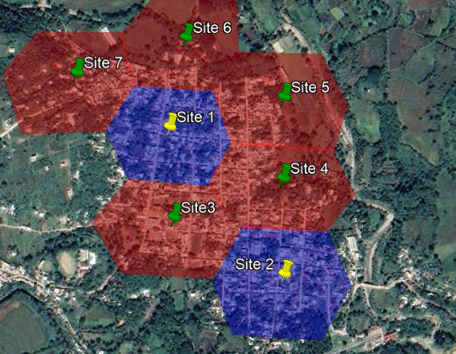
RAN HLD

Slide 11
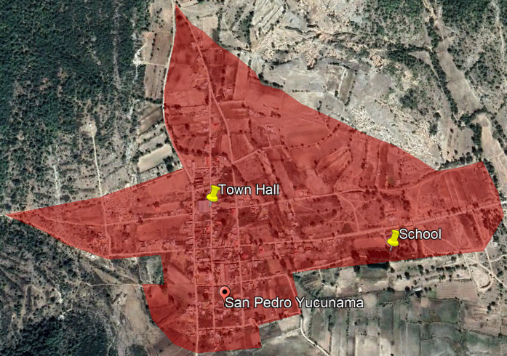
RAN HLD

Slide 12
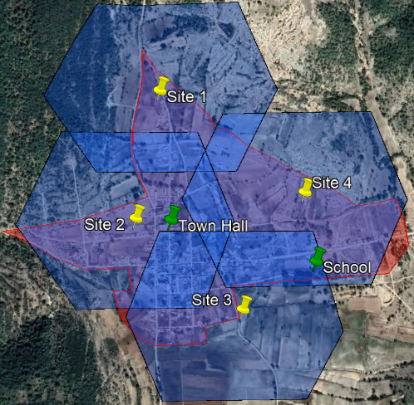
RAN HLD

Slide 13
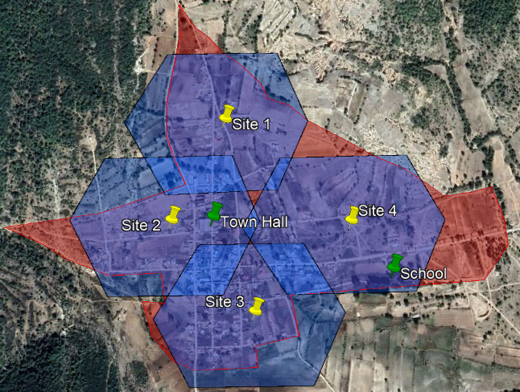
RAN HLD

